Slide 1


SMART INDIA HACKATHON 2024
TITLE PAGE
Problem Statement ID –1650
Problem Statement Title-Early Warning System foe glacial outburst floods
Theme-Management Disaster
PS Category- Software
Team ID-
Team Name –HuGs for BuGs

Slide 2
IDEA TITLE
Hugs for BuGs
Proposed Solution ( Idea/Solution/Prototype)
To mitigate the risk of Glacial Lake Outburst Floods (GLOFs), we propose an Early Warning System (EWS) that combines satellite imagery, ground-based sensors, and machine learning.
This system will monitor key factors such as lake size, water levels, and dam stability to detect early signs of potential outbursts. Machine learning will analyse data to provide timely alerts through SMS and mobile apps.
The solution aims to enhance safety, reduce economic losses, and protect the environment, with a phased implementation plan including pilot testing, deployment, and continuous improvement.

Slide 3
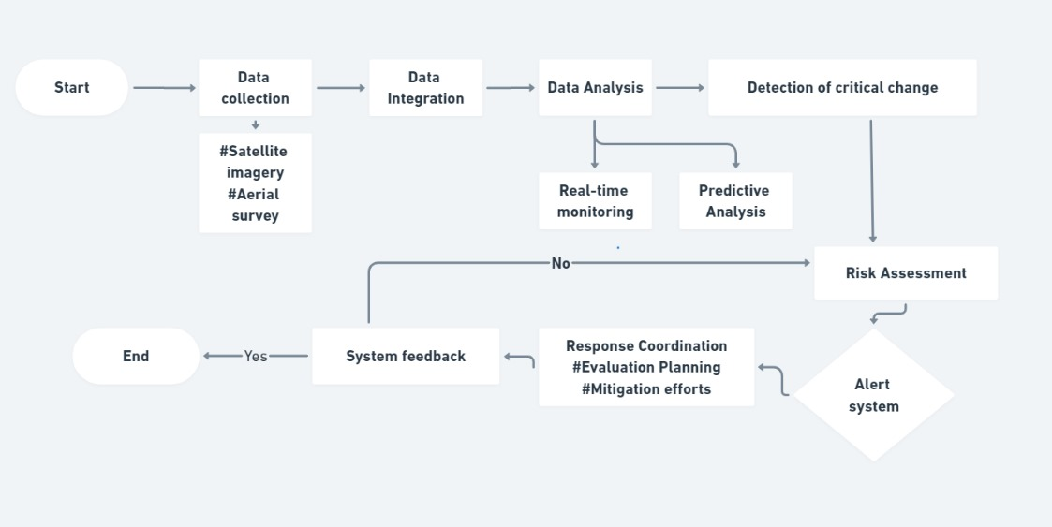
TECHNICAL APPROACH
HuGs for BuGs
Remote Sensing: Google Earth Engine,
Data Collection: HTTP, Apache Kafka
Database Management: PostgreSQL with PostGIS, MongoDB
Machine Learning: Python, scikit-learn, PyTorch, Pandas, NumPy
Geospatial Analysis: GDAL, Shapely
Visualization: Streamlit, Seaborn
Alert System: Twilio
Web Frameworks: Flask, Django

Slide 4
FEASIBILITY AND VIABILITY
HuGs for BuGs
The Early Warning System (EWS) for Glacial Lake Outburst Floods (GLOFs) is both feasible and viable.
Technically, it leverages established technologies such as remote sensing, machine learning, and real-time data processing.
Resource-wise, these tools are accessible and come with strong community support, while the necessary expertise in data science, software development, and geospatial analysis is readily available.
Economically, the system is cost-effective, utilizing open-source tools and scalable cloud services to manage expenses efficiently.
In terms of impact, it will significantly enhance safety by providing timely warnings and reducing potential losses from GLOFs.
Sustainability is ensured through a modular design that allows for ongoing updates and integration with other systems.
Scalability is built-in, enabling the system to expand to additional glacial lakes and integrate with broader disaster management frameworks.

Slide 5
IMPACT AND BENEFITS
HuGs for BuGs
The Early Warning System (EWS) for Glacial Lake Outburst Floods (GLOFs) significantly improves safety by providing timely warnings, allowing for early evacuation and risk reduction. It reduces economic losses through proactive measures and helps protect the environment by preventing damage from floods. The system is cost-effective, using open-source tools and cloud services, and is scalable to cover more lakes and integrate with broader disaster management efforts. Its design ensures sustainability with the ability for future updates and enhancements.

Slide 6
RESEARCH AND REFERENCES
HuGs for BuGs
Glacial lake outburst floods threaten millions globally [https://www.nature.com/articles/s41467-023-36033-x]
Future Glacial Lake Outburst Flood (GLOF) hazard of the South Lhonak Lake, Sikkim Himalaya [https://www.sciencedirect.com/science/article/pii/S0169555X21001914]
Artificial Intelligence to Monitor Kyrgyzstan’s Glacial Lakes to Prevent Outburst Flooding
[https://timesca.com/artificial-intelligence-to-monitor-kyrgyzstans-glacial-lakes-to-prevent-outburst-flooding/]

Slide 7
IMPORTANT INSTRUCTIONS
Please ensure below pointers are met while submitting the Idea PPT:
Kindly keep the maximum slides limit up to six (6). ( Including the title slide)
Try to avoid paragraphs and post your idea in points /diagrams / Infographics /pictures
Keep your explanation precise and easy to understand
Idea should be unique and novel.
You can only use provided template for making the PPT without changing the idea details pointers (mentioned in previous slides).
You need to save the file in PDF and upload the same on portal. No PPT, Word Doc or any other format will be supported.
Note - You can delete this slide (Important Pointers) when you upload the details of your idea on SIH portal.

